Slide 1


Slide 2

WHAT DOES THIS DATASET CONTAIN?
Order Data
Order date
Ship mode
Ship date
Order id
Product Data
Product Name
Product ID
Category
Sub Category
Customer data
Customer Name
Customer ID
Segment
Numbers
Sales
Profit
Quantity
Discount
Geographics data
Country
City
State
Region
TYPE OF FILE | (.xls)
SIZE | 3.01 MB
NO. OF ROWS | 10000
NO. OF COLUMNS | 20

Slide 3

EU Superstore Database
Reviewing Data
Analysis Performed
AGENDAS
Customer Analysis
Sales Analysis
Order Analysis
Discount Analysis
Dashboard
Profit Analysis

Slide 4

EU SUPERSTORE DATASET REVIEWING AND CLEANING
EU SUPERSTORE DATA SET CLEANING PROCESS
# what does each row represent? ```{r}head(df_eu_storeData)``` it seems like a unique combination of order id and product id ## confirming ```{r}df_eu_storeData |> distinct(`Order ID`, `Product ID`) |> nrow()``` found 9 rows with duplication ## extracting product id duplicates ```{r}df_eu_storeData |> group_by(`Order ID`) |> count(`Product ID`) |> head(10)```
### another way to do the same ```{r}df_eu_storeData |> group_by(`Order ID`, `Product ID`) |> summarise(n = n()) |> head(10)``` ## observing duplicate rows ```{r}df_eu_storeData |> group_by(`Order ID`) |> count(`Product ID`) |> arrange(desc(n)) |> head(10)df_eu_storeData |> group_by(`Order ID`) |> count(`Product ID`) |> filter(n > 1)``` ```{r}df_eu_storeData |> group_by(`Order ID`) |> count(`Product ID`) |> filter(n > 1) |> inner_join(df_eu_storeData)```
### Cases : 1. different quantities, all else same 2. duplicate 3. different customers ES-2016-3945862

Slide 5
EU SUPERSTORE DATA SET REVIEWING PROCESS
DATASET CONTAINS SAME ORDER IDs FOR DIFFERENT CUSTOMER IDs WHICH IS CREATING ERRORS IN ANALYSIS TO RESOLVE THIS ANOTHER COLUMN IS CREATED BY COMBINATION OF ORDER ID AND CUSTOMER ID WHICH GAVE US UNIQUE ORDER LEVEL VARIABLE
R CODE : df_eu_storedata <- eu_storedata |> mutate(Order_ID = paste(`Order ID`, `Customer ID`, sep = '_'))

Slide 6
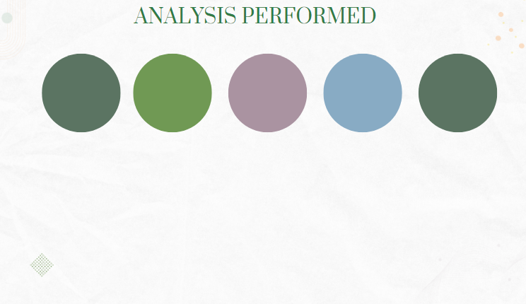
CUSTOMER ANALYSIS
PROFIT ANALYSIS
DISCOUNTANALYSIS
ORDER ANALYSIS
SALES ANALYSIS

Slide 7

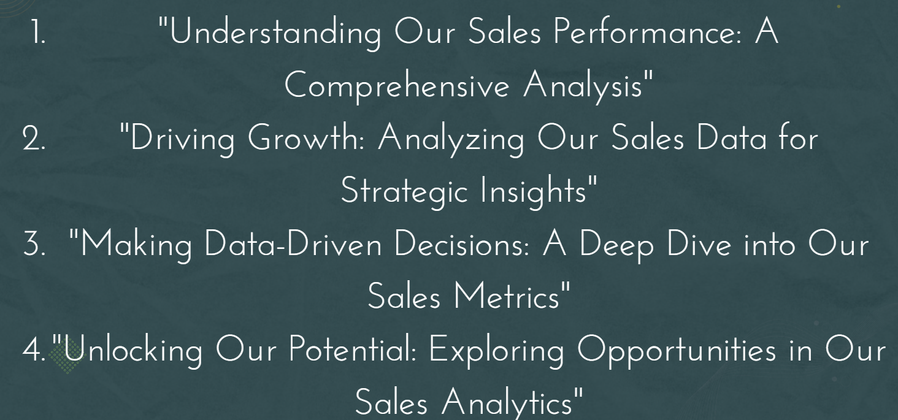
SALES ANALYSIS

Slide 8
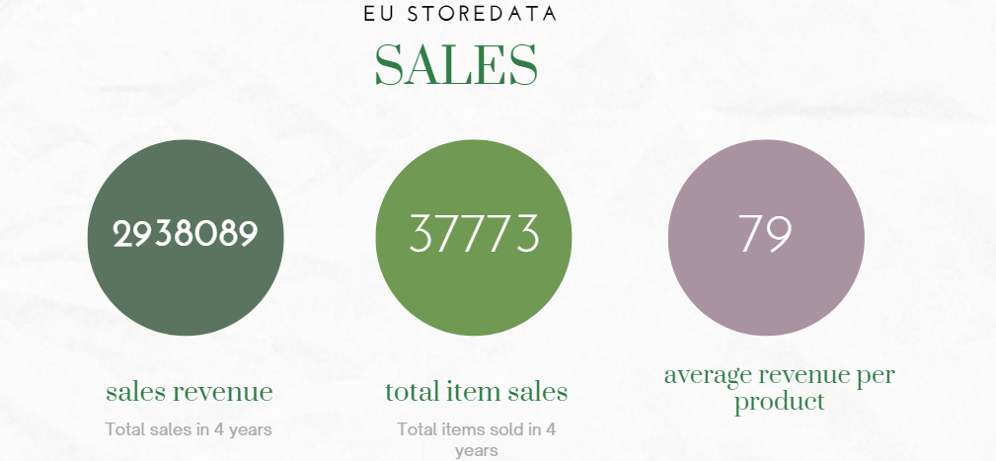

Slide 9
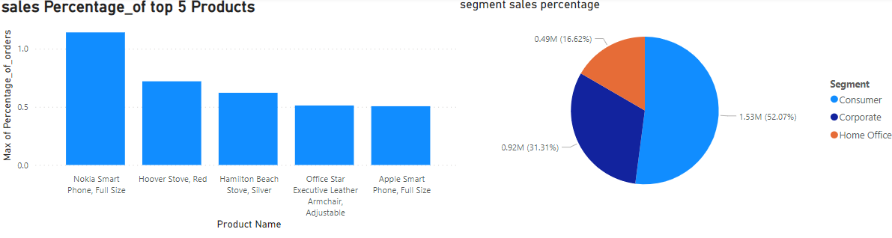
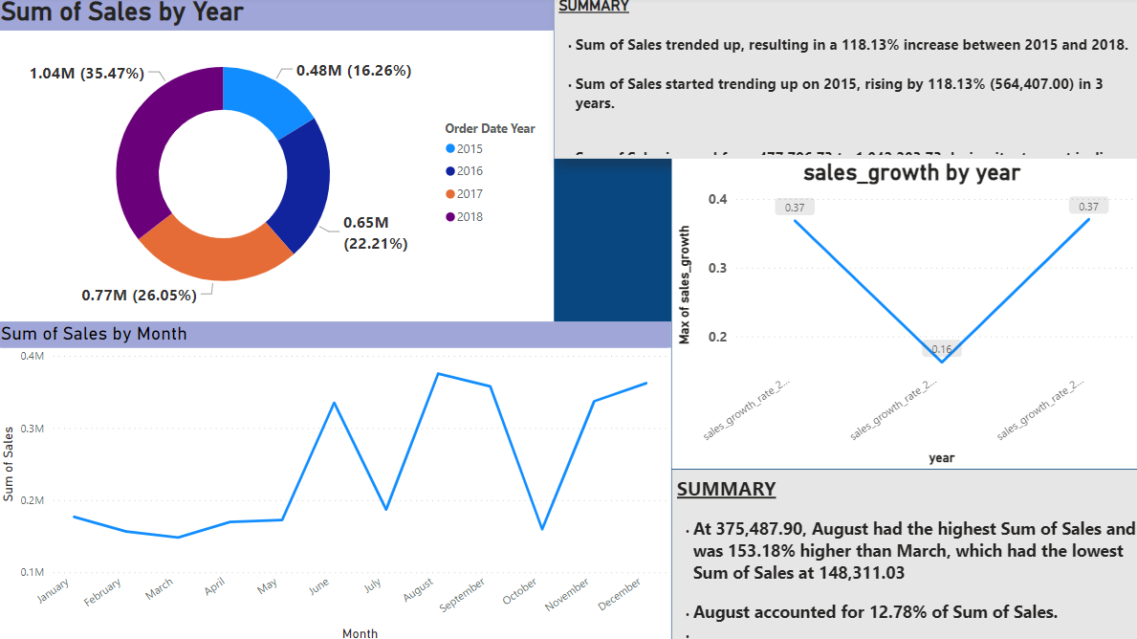
REFER TO POWER BI FOR REPORT

Slide 10
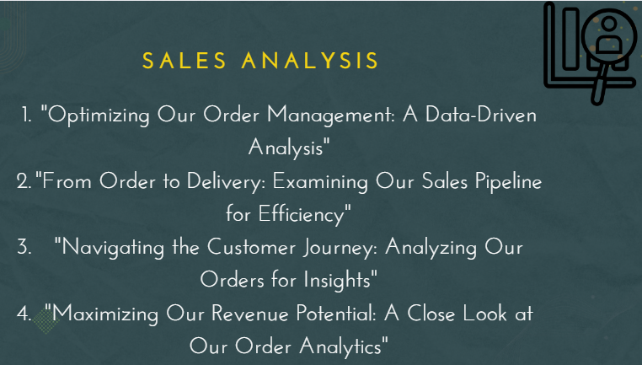
ORDER ANALYSIS

Slide 11
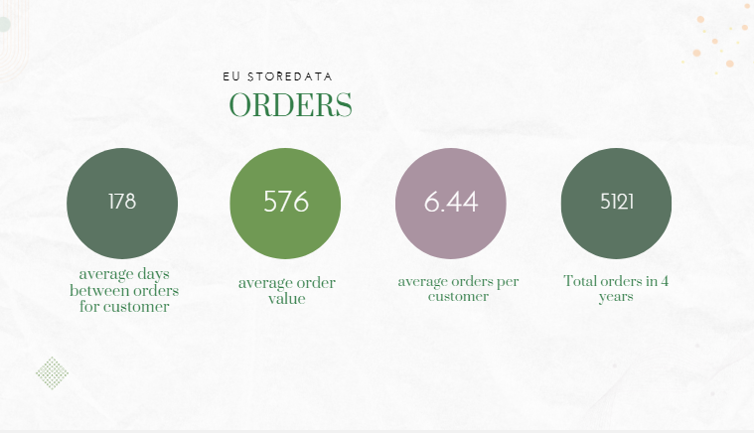

Slide 12
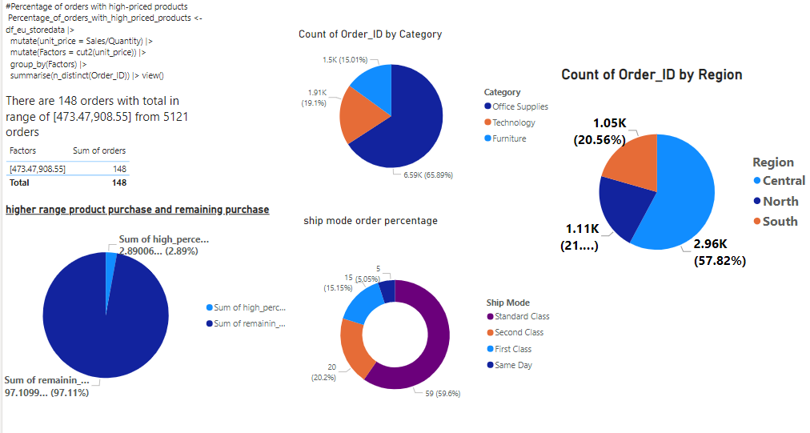
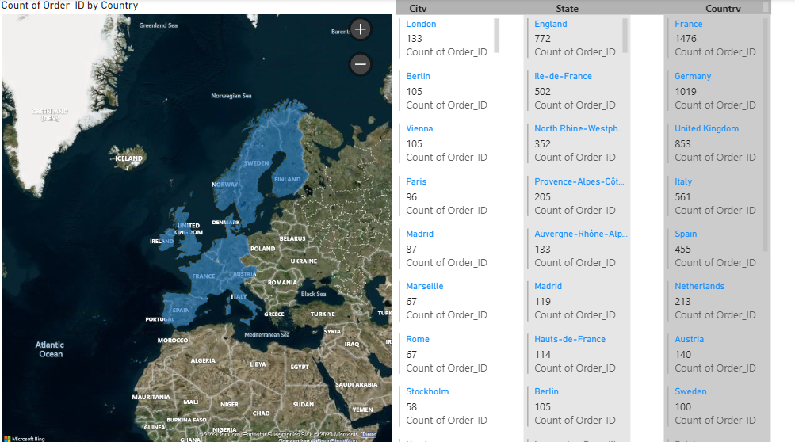
Products | order percentage product
Eldon File Cart, Single Width | 0.3
Rogers File Cart, Single Width | 0.2702432
Sanford Pencil Sharpener, Water Color | 0.2702432
Stanley Pencil Sharpener, Water Color | 0.2502252
Avery Index Tab, Clear | 0.2402162
Rest | 98.67
REFER TO POWER BI FOR REPORT

Slide 13

CUSTOMER ANALYSIS

Slide 14
CUSTOMER LIFETIME VALUE
CUSTOMER VALUE “3711.283”
CUSTOMER LIFE SPAN “2.71042 YEARS”
AVG. ORDER PER YEAR BY CUSTOMERS “2.058071”
CUSTOMER LIFETIME VALUE “20702”
R CODE FOR CLV(CUSTOMER LIFETIME VALUE) Final_submissions |> mutate(CV = mean(total_transactions) * mean(average_order_value)) |> mutate(CLS = mean(difftime(date_last_transaction, date_first_transaction, units = "days") / 365)) |> left_join(df_eu_storedata |> mutate(year = lubridate::year(`Order Date`)) |> group_by(`Customer ID`, year) |> summarise(year_finding = n_distinct(Order_ID)) |> group_by(`Customer ID`) |> summarise(avg_order_per_year = mean(year_finding)), by = "Customer ID") |> summarise(dataset_avg_order_per_year = mean(avg_order_per_year), CLV = as.integer(CV * CLS * dataset_avg_order_per_year))

Slide 15
New Customer Revenue Retention (NCRR) 2018
Revenue lost due to churn = 0
Revenue from new customers 2017 = 677983.8
Revenue from new customers 2018 = 850278.6
NCRR = 125.4128%
FORMULA : NCRR = (revenue_from_new_customers_2018 - revenue_lost_due_to_churn) / revenue_from_new_customers_2017 * 100
Finding New Customer Revenue Retention (NCRR) R CODE # Identify new customers who made their first purchase in 2017new_customers_2017 <- df_eu_storedata |> group_by(`Customer ID`) |> summarise(first_purchase_date = min(`Order Date`)) |> filter(first_purchase_date >= '2017-01-01' & first_purchase_date <= '2017-12-31') |> select(`Customer ID`) # Identify customers who made purchases in both 2017 and 2018customers_2017_2018 <- df_eu_storedata |> group_by(`Customer ID`) |> summarise(total_sales_2017 = sum(Sales[`Order Date` >= '2017-01-01' & `Order Date` <= '2017-12-31']), total_sales_2018 = sum(Sales[`Order Date` >= '2018-01-01' & `Order Date` <= '2018-12-31'])) |> filter(total_sales_2017 > 0 & total_sales_2018 > 0) |> select(`Customer ID`) # Calculate NCRR NCRR <- (df_eu_storedata |> filter(`Customer ID` %in% customers_2017_2018$`Customer ID`) |> group_by(`Customer ID`) |> summarise(total_sales_2017 = sum(Sales[`Order Date` >= '2017-01-01' & `Order Date` <= '2017-12-31']), total_sales_2018 = sum(Sales[`Order Date` >= '2018-01-01' & `Order Date` <= '2018-12-31']))) |> left_join(new_customers_2017, by = 'Customer ID') |> summarise(revenue_from_new_customers_2017 = sum(total_sales_2017), revenue_lost_due_to_churn = sum(total_sales_2017[is.na(total_sales_2018)]), revenue_from_new_customers_2018 = sum(total_sales_2018[!is.na(total_sales_2018)])) |> mutate(NCRR = (revenue_from_new_customers_2018 - revenue_lost_due_to_churn) / revenue_from_new_customers_2017 * 100)

Slide 16
CHURN RATE FOR FOUR YEARS
11.2%
Calculate churn rate R CODE : df_eu_storedata |> group_by(`Customer ID`) |> summarise(last_purchase_date = max(`Order Date`)) |> mutate(churned = ifelse(last_purchase_date < "2018-01-01", 1, 0)) |> summarise(churn_rate = (sum(churned)/n()) * 100)

Slide 17
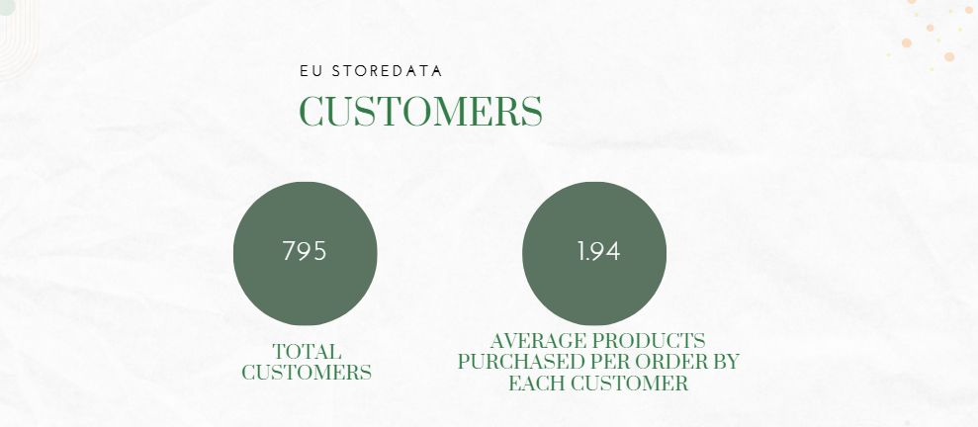

Slide 18
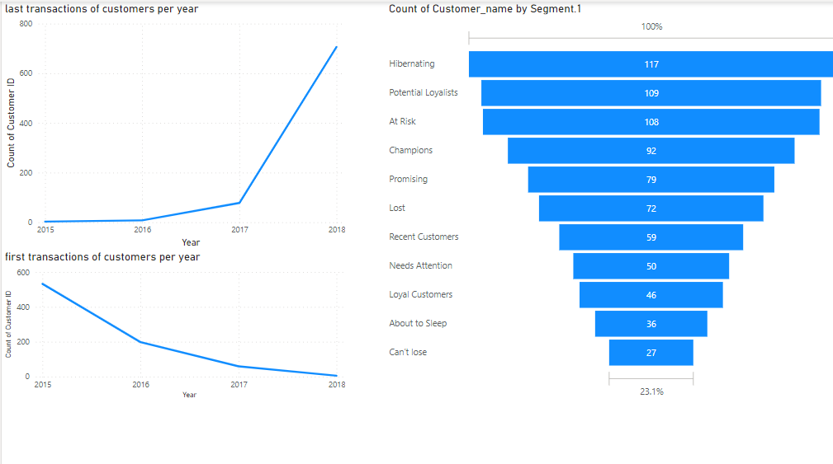
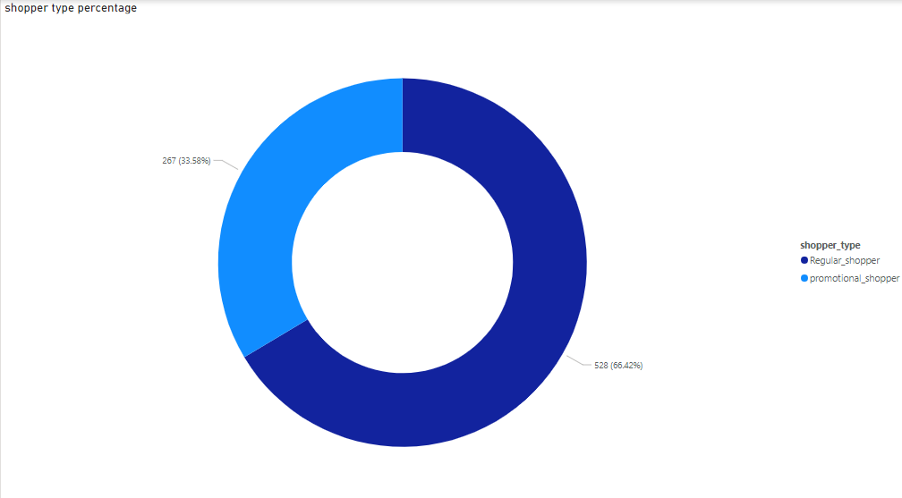
REFER TO POWER BI FOR REPORT

Slide 19
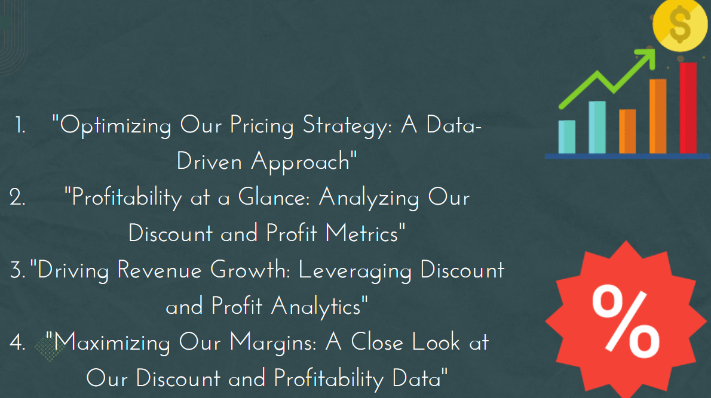
DISCOUNTS AND PROFITS ANALYSIS

Slide 20
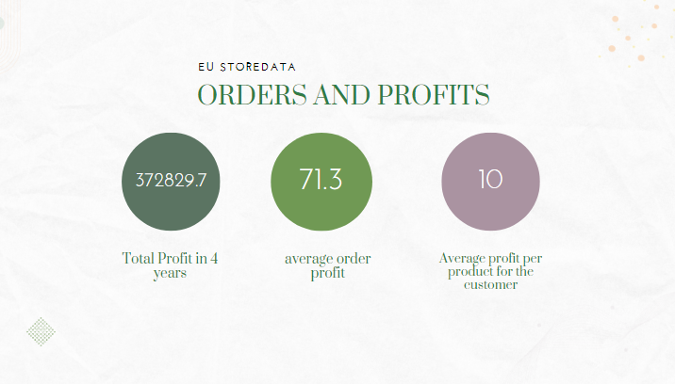

Slide 21
AVERAGE DISCOUNT PER CUSTOMER
AVERAGE DISCOUNT PER ORDER FOR EACH CUSTOMER
20.113%
10.3%

Slide 22
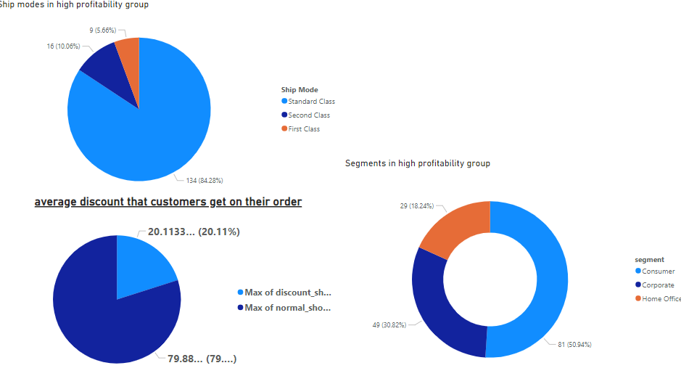
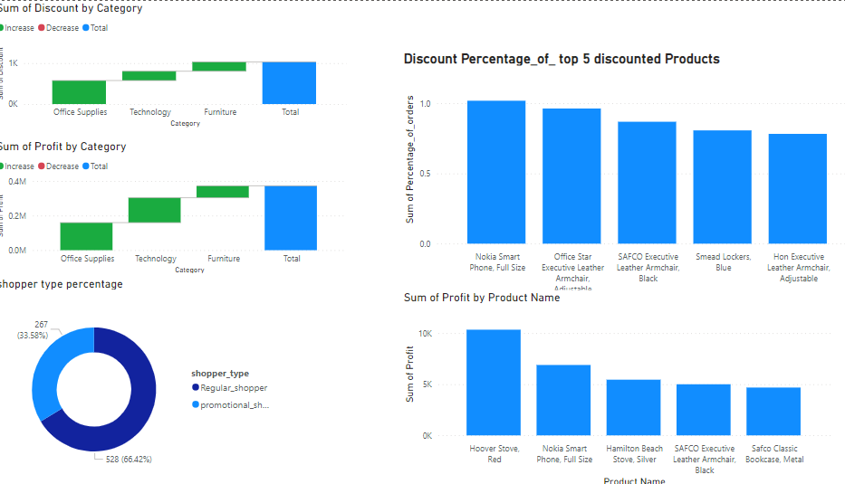
REFER TO POWER BI FOR REPORT

Slide 23
THANKYOU
QUESTIONS & ANSWERS

